Slide 1
Modeling site-specific amino-acid preferences deepens phylogenetic estimates of the divergence of viral proteins
Notes:
Color scheme
black = "black”
blue = "#439FC3”
green = "#397262”
orange = "#F9842A”
red = "#B52A24”
pink = "#CC79A7"

Slide 2
Notes
The raw figures come from `figures.ipynb` in this directory.
If you don’t change the size of the output figure you should be able to plop them into this presentation to produce the final figures.

Slide 3
MAIN FIGURES

Slide 4
Model feature comparison

Slide 5
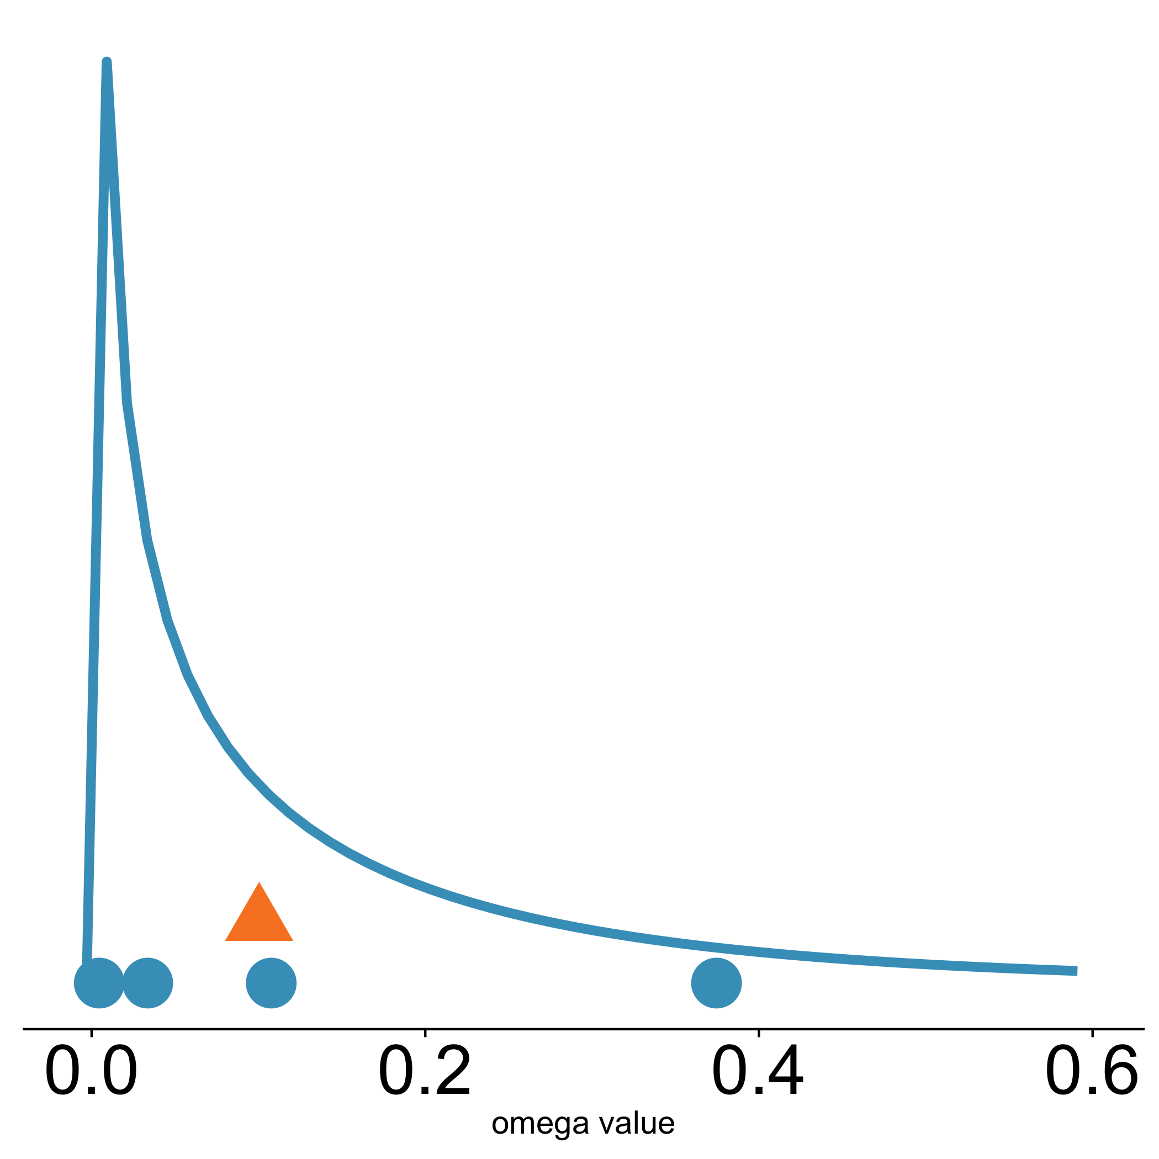
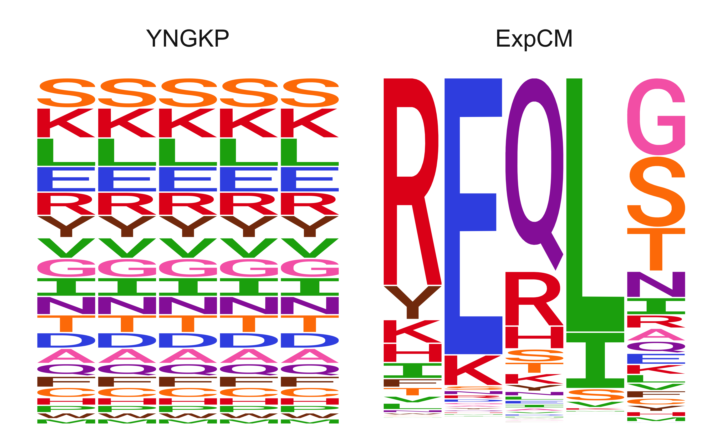

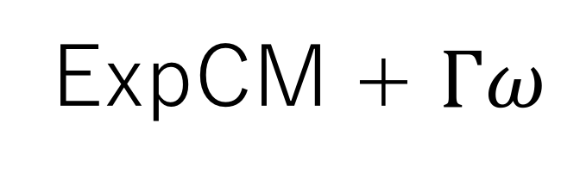
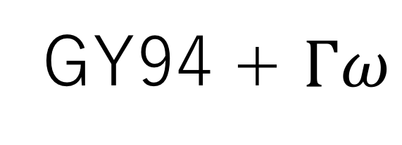
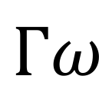


A
B
C
Uniform stationary state
Site-specific stationary state
Site-specific stationary state
$Γω$ rate variation
$ω$ value
$$Γω$$
GY94
single value
GY94 + $Γω$
ExpCM
ExpCM + $Γω$
$ω$ value

Slide 6
Decay to stationary state

Slide 7
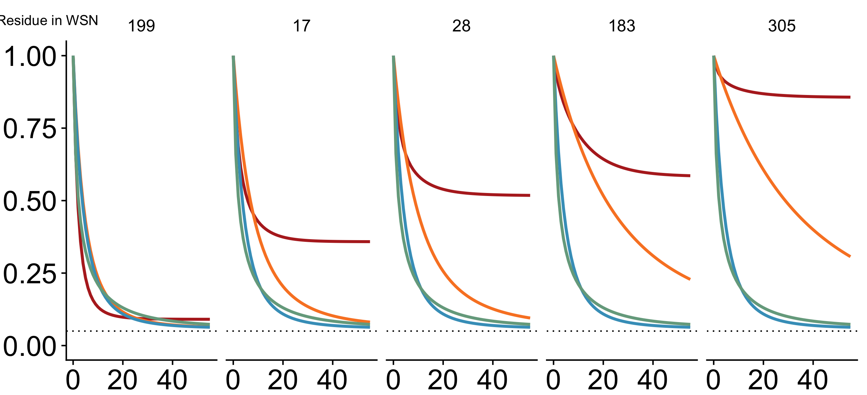
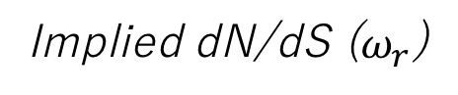
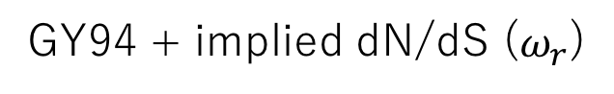
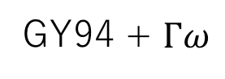
199
17
28
183
305
Site in HA
0.91
0.46
0.36
0.14
0.10
Implied dN/dS ($ω_{r}$)
Model
ExpCM
Expected pairwise amino-acid identity
GY94
GY94 + $Γω$
GY94 + implied dN/dS ($ω_{r}$)
Branch length (codon substitutions per site)

Slide 8
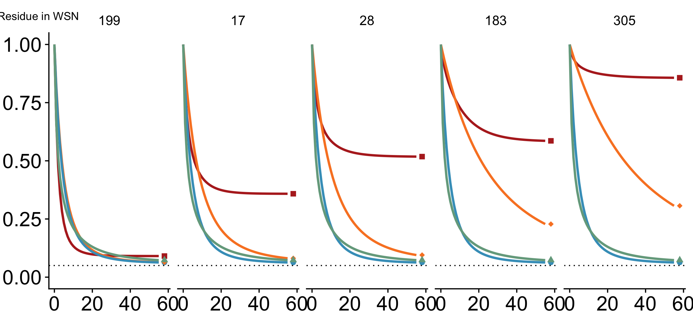
199
17
28
183
305
Site in HA
0.91
0.46
0.36
0.14
0.10
Implied dN/dS ($ω_{r}$)
Model
ExpCM
Expected pairwise amino-acid identity
GY94
GY94 + $Γω$
GY94 + implied dN/dS ($ω_{r}$)
Branch length (codon substitutions per site)

Slide 9
Simulations

Slide 10
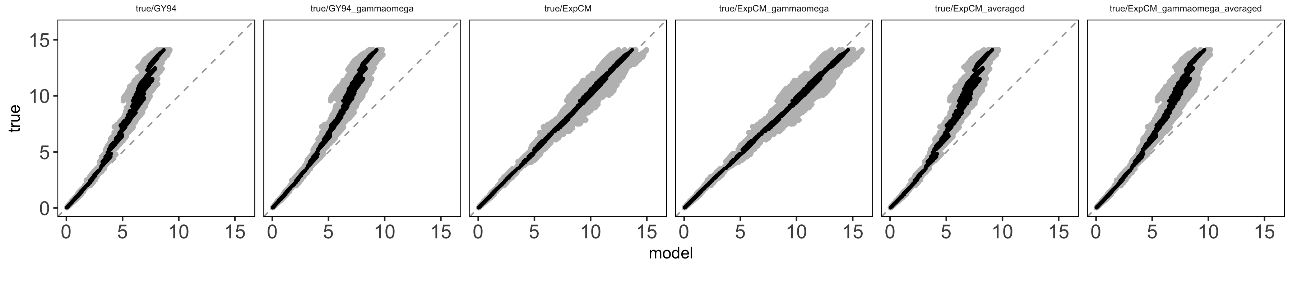
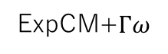
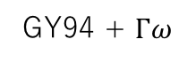
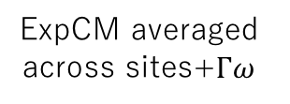
Actual branch length
GY94
GY94 + $Γω$
ExpCM
ExpCM+$Γω$
ExpCM averaged across sites
ExpCM averaged across sites+$Γω$
Branch length optimized by the model

Slide 11
Model Comparison Trees

Slide 12
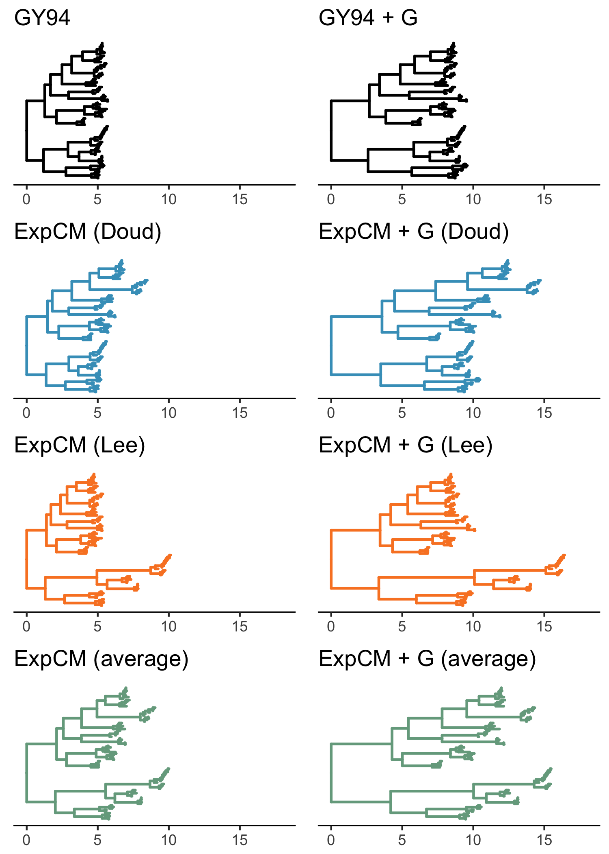
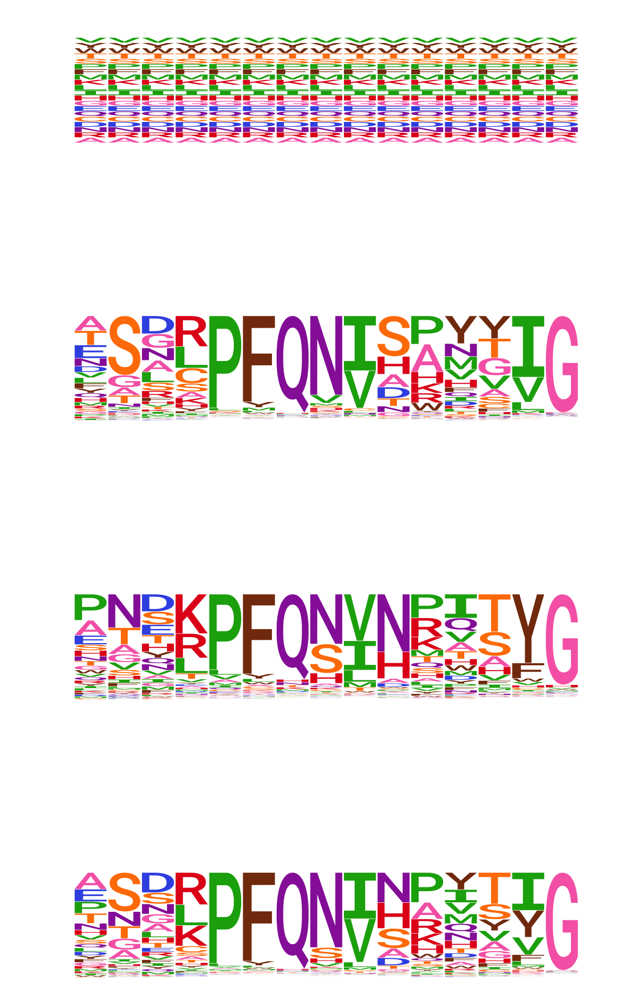

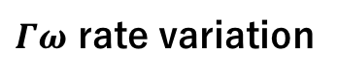
No rate variation
$Γω$ rate variation
GY94
ExpCM + $Γω$
ExpCM (H1)
ExpCM (H3)
ExpCM (H1+H3 avg)
Branch length (average codon substitutions per site)

Slide 13
Competing effects

Slide 14
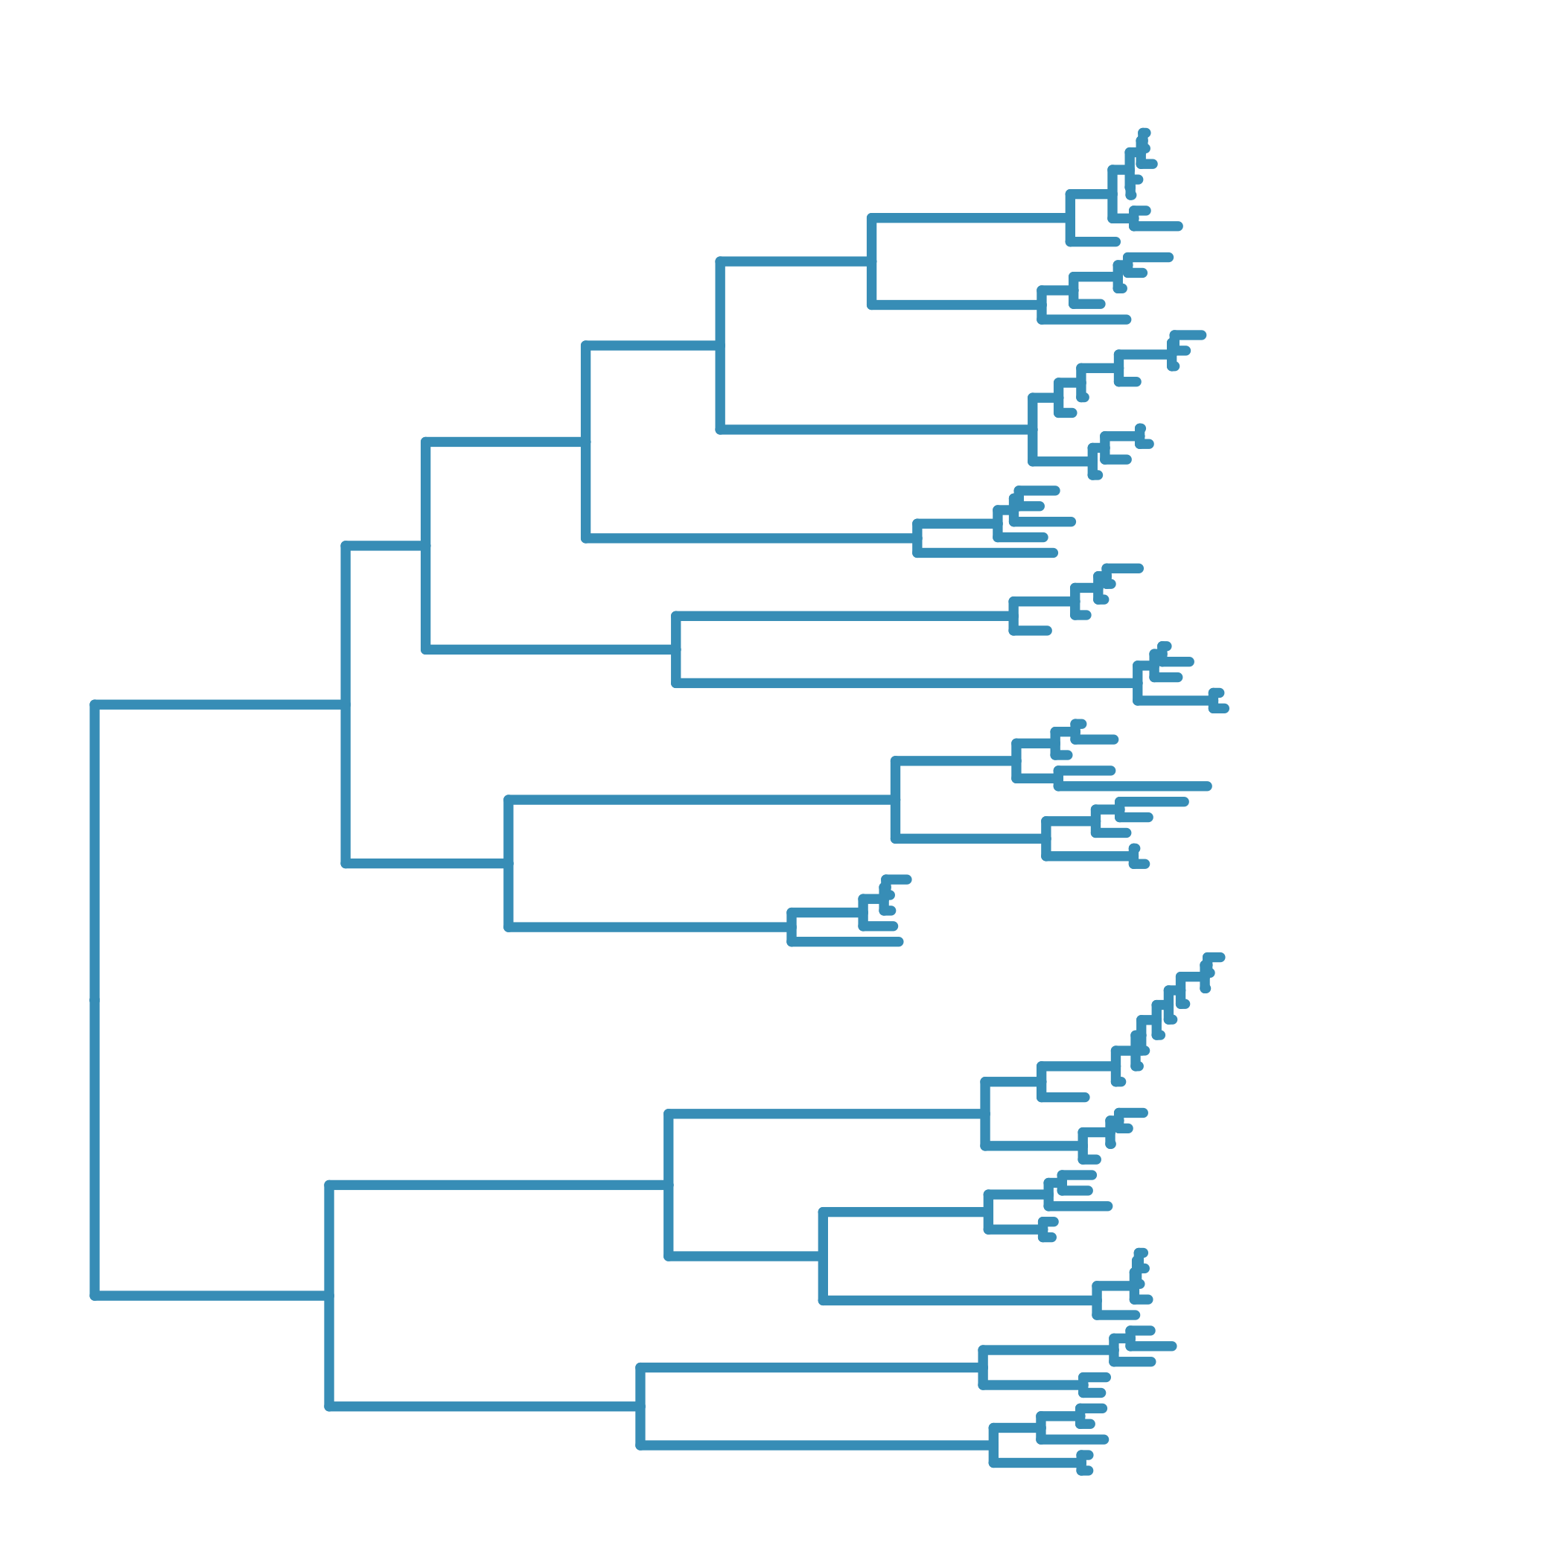

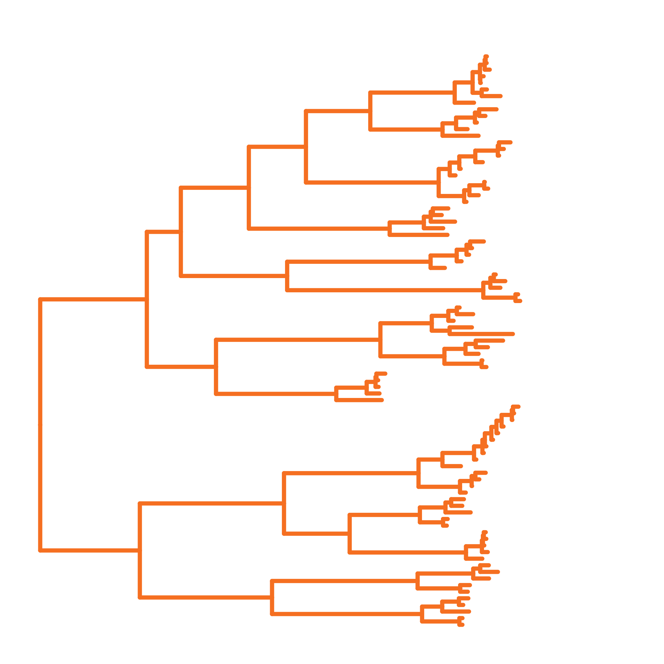
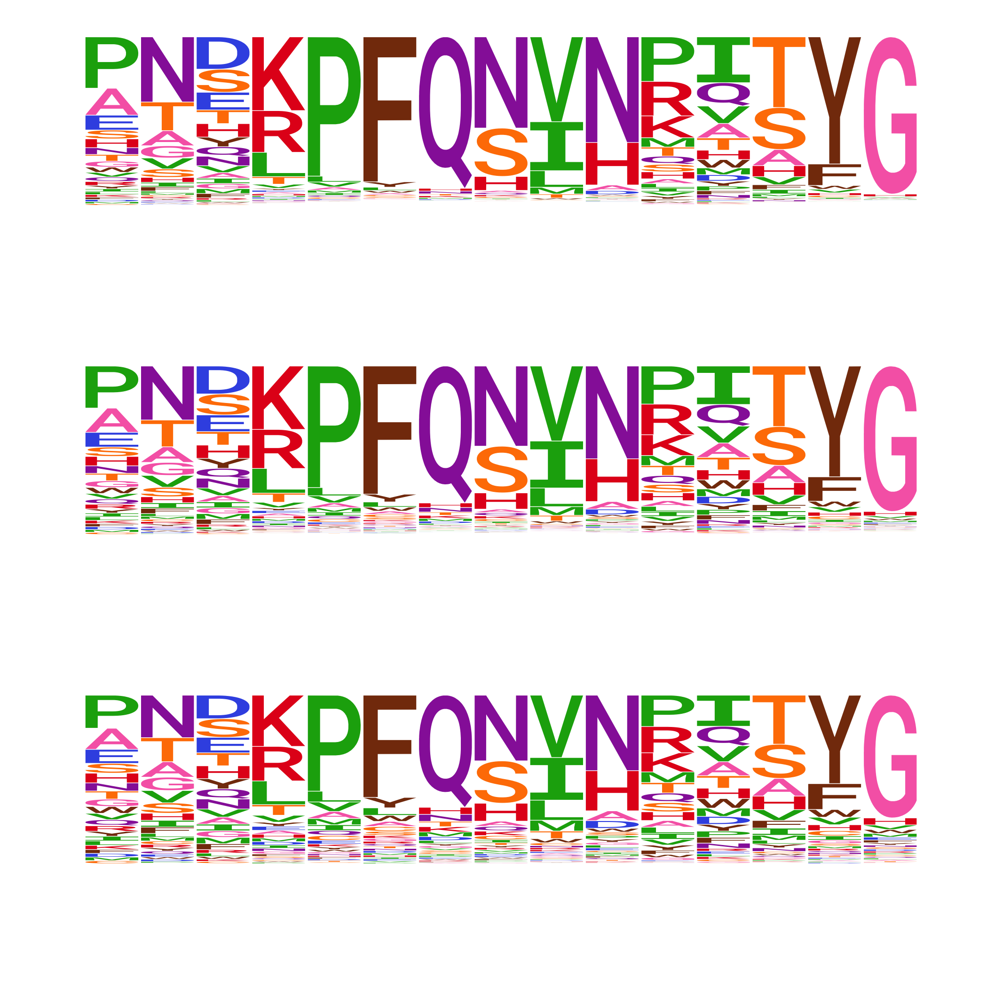
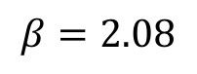
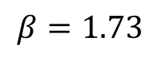
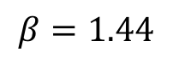
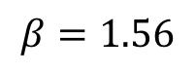
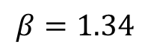
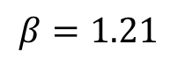
ExpCM(H1 prefs)
low
$$β=1.56$$
low
intermediate
$$β=1.34$$
intermediate
high
$$β=1.21$$
high
ExpCM(H3 prefs)
high
low
$$β=2.08$$
intermediate
intermediate
low
$$β=1.73$$
high
$$β=1.44$$

Slide 15
`phylobayes`

Slide 16
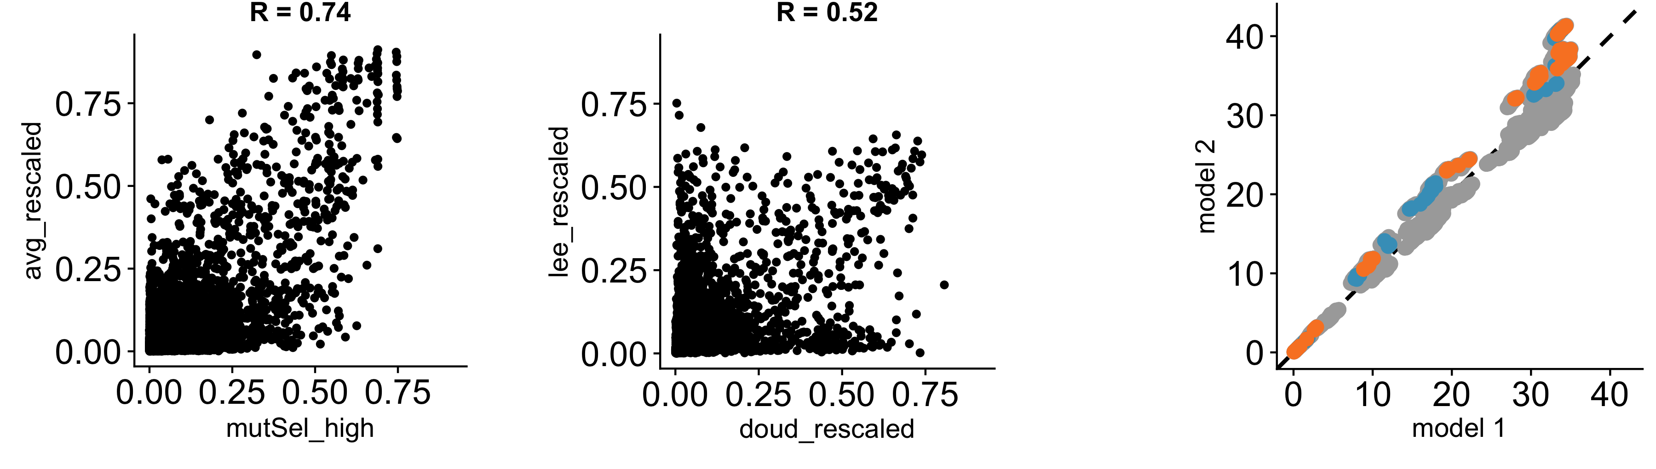

A
B
Branch leading to
H1
H3
r = 0.74
r = 0.52
ExpCM H1+H3 avg prefs
ExpCM+$Γω$ (H1+H3 avg) normalized branch length
ExpCM H3 prefs
pbMutSel prefs
ExpCM H1 prefs
pbMutSel normalized branch length

Slide 17
SUPPLEMENTARY FIGURES

Slide 18
Divergence distances

Slide 19
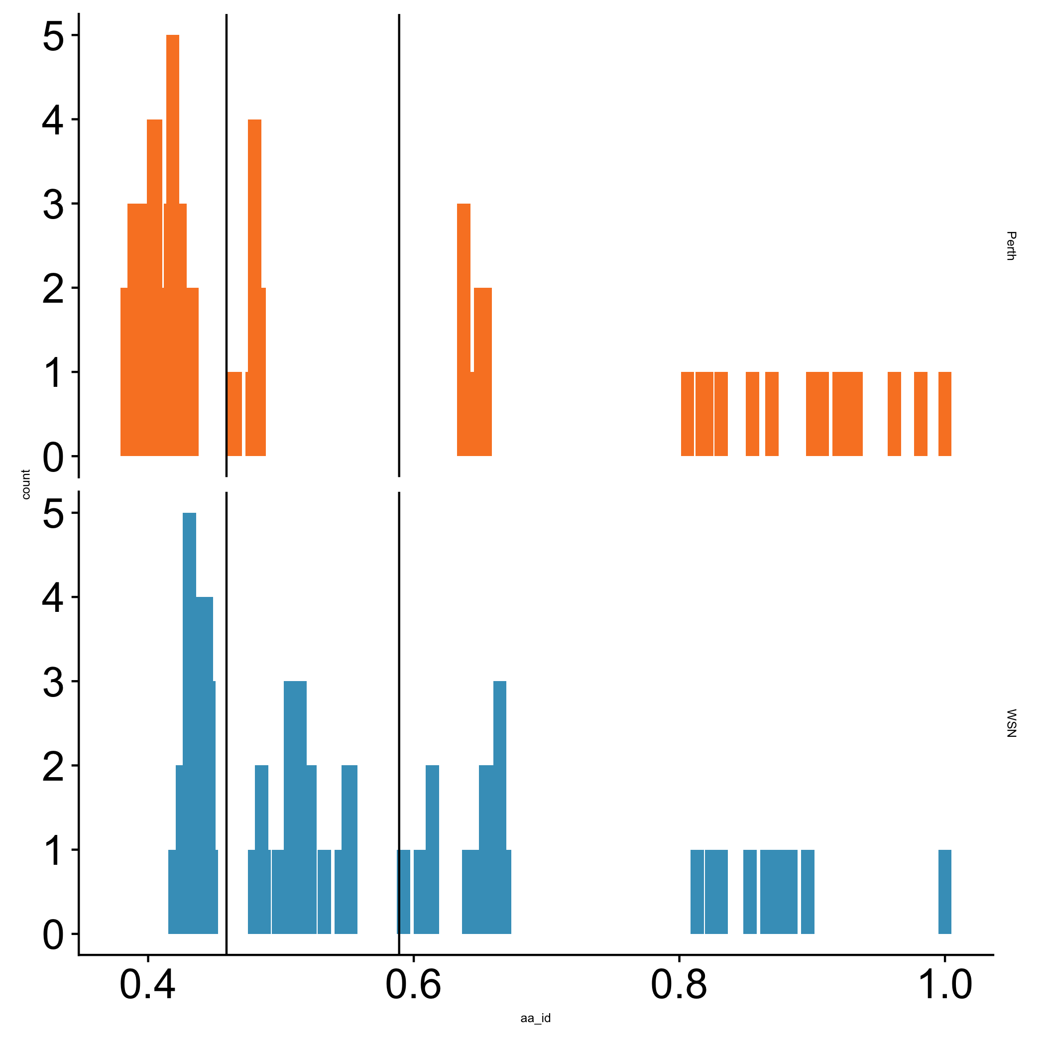
H3 reference sequence
Number of sequences
H1 reference sequence
Amino-acid identity to reference

